Slide 1
Un-Restricted
Unleash your appetite

Slide 2
Trouble Finding a place to eat?
Notes:
Introduction slide:
Narrator: Has this ever happened to you?
P1: Hey <insert name here> wanna get something to eat?
P2: Sure man there’s a pizza joint nearby
P1: Nah man I can’t go there, I have celiac’s
P2: Sure, what about this ramen place
P1: …. Noodles are basically gluten
P2: ummm…. Okay lets just go to this brewery
P1: My Dude…beer is Barley….I can’t have that
P2: OH MY GOD is there anything you can eat??? This is soooo frustrating to deal with!!!
P1: Uggg if only there was a service that we could use to find gluten free restaurants that don’t completely suck
<P1 and P2 look into the audience>
P3: *from audience* Ummmmm have you guys never used Unrestricted???
P1 & P2: What’s unrestricted????

Slide 3
What is Unrestricted?
Notes:
*P3 takes center stage*
P3: unrestricted is a revolutionary new app that allows you to put in your dietary restrictions and gives recommendations on restarants in your area that meet your dietary needs!
P2: Wow!! That’s amazing!
P1: Okayy but how does it work?

Slide 4
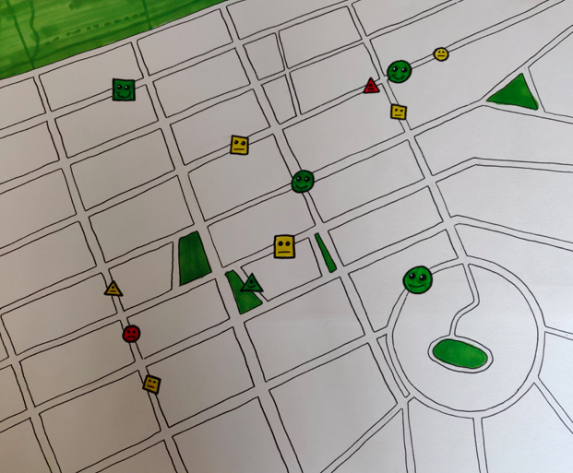

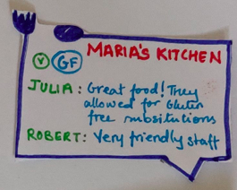
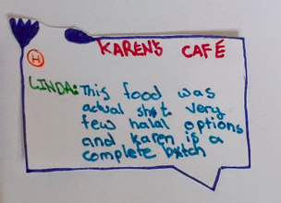
Notes:
Unrestricted works by allowing users to search for restaurants that meet their dietary resctrictions
By looking at the map we can see different resturants illustrated as different creatures
Red creatures indicate negative reviews
P1: oooh lets look at this one:
P2: oh man…. That’s aggressive
P3: yeah… Lets look at a more positive one
P2: ahh much better!
Awesome! What other features can be included in the

Slide 5
What else Can it DO?
Customize dietary restrictions and preferences
Investigate additional reviews
Leave reviews
Notes:
P3: reads out what unrestricted can do
P3: Here’s a short video illustrating all the features that unrestricted has to offer!

Slide 6

Notes:
*play video*

Slide 7
Future Implementations
Looking at restaurant opening and closing hours
Adding more customizations to search for restaurants outside of their local area

Slide 8
A solution to Un-restrict Your Appetite

